Slide 1
函数式编程原理
Lecture 5

Slide 2
上节课内容回顾
以排序算法为例
  list类型的应用
  插入排序(Insertion Sort)
    ins : int * int list -> int list
    isort : int list -> int list
程序描述、编码及正确性验证

Slide 3
整数的插入——ins
ins : int * int list -> int list
(* REQUIRES L is a sorted list *)
(* ENSURES ins(x, L) = a sorted perm of x::L *)
fun ins (x, [ ]) = [x]
| ins (x, y::L) = case compare(x, y) of
GREATER => y::ins(x, L)
| _ => x::y::L
For all sorted integer lists L,
ins(x, L) = a sorted permutation of x::L.

Slide 4
插入排序——isort
isort : int list -> int list
(* REQUIRES true *)
(* ENSURES isort(L) = a sorted perm of L *)
fun isort [ ] = [ ]
| isort (x::L) = ins (x, isort L)
For all integer lists L,
isort L = a sorted permutation of L.

Slide 5
插入排序——isort
isort : int list -> int list
(* REQUIRES true *)
(* ENSURES isort(L) = a sorted perm of L *)
fun isort [ ] = [ ]
| isort (x::L) = ins (x, isort L)
[5, 4, 3, 2, 1]怎么排的？

Slide 6
插入排序——isort
[5, 4, 3, 2, 1]怎么排的？
isort : int list -> int list
fun isort [ ] = [ ]
| isort (x::L) = ins (x, isort L)
isort (5::[4, …, 1])
= ins (5, isort [4, …, 1])
= ins (5, ins(4, isort [3, 2, 1]))
= ins (5, ins(4, ins(3, isort [2, 1]))
= ins (5, ins(4, ins(3, ins(2, isort[1])))
= ins (5, ins(4, ins(3, ins(2, [1])))
= …

Slide 7
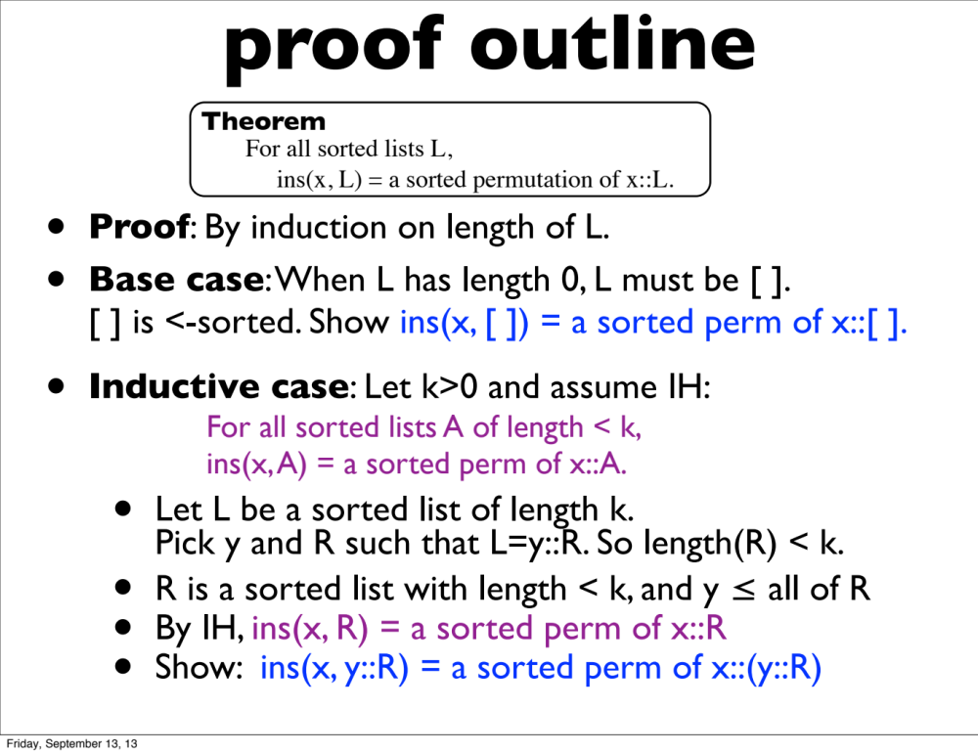
插入排序——isort

Slide 8
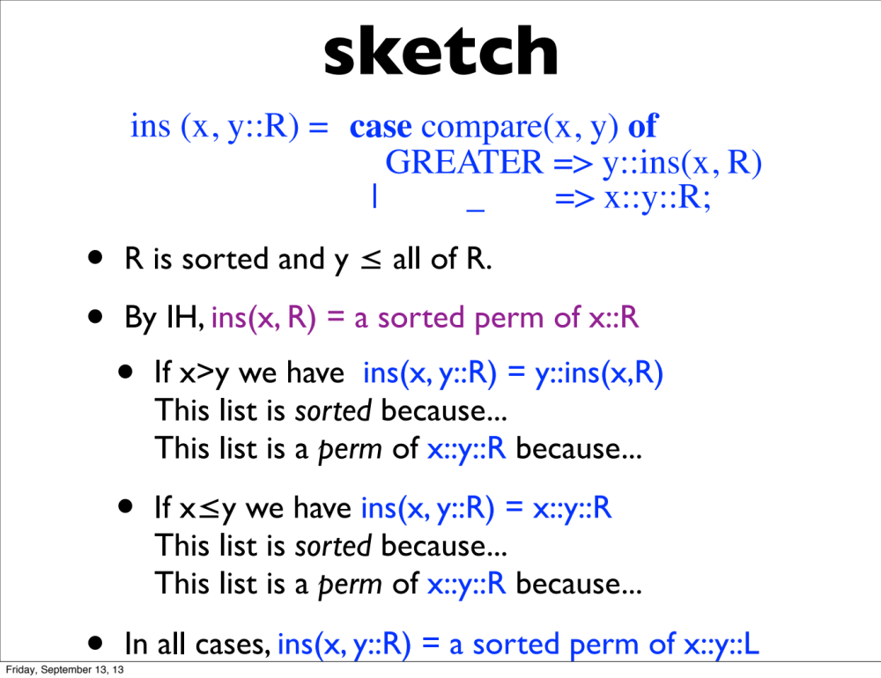
插入排序——isort

Slide 9
另一个插入排序——isort’
isort’ : int list -> int list
fun isort’ [ ] = [ ]
| isort’ [x] = [x]
| isort’ (x::L) = ins (x, isort’ L);
isort and isort’ are extensionally equivalent.
For all L : int list, isort L = isort’ L.

Slide 10
归并排序
基本思想：采用分治法（Divide and Conquer）将已有序的子序列合并，得到完全有序的序列；即先使每个子序列有序，再使子序列段间有序。
操作步骤：
  将n个元素分成两个含n/2元素的子序列
  将两个子序列递归排序
  合并两个已排序好的序列
split : int list -> int list * int list
merge : int list * int list -> int list

Slide 11
善于使用帮助(helper)函数
如何实现更加复杂的函数功能？
  状态的记录和改变
  更复杂的递归
  Helper functions

Slide 12
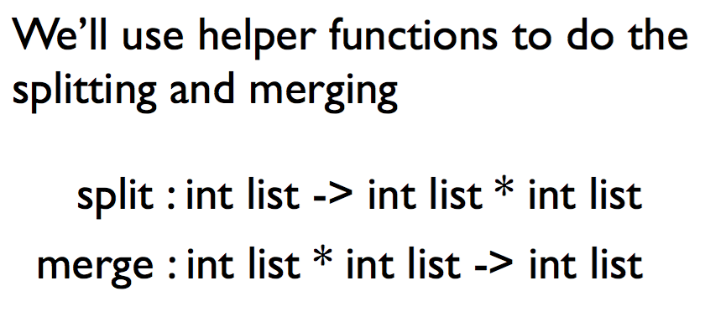
善于使用帮助(helper)函数

Slide 13
表的分割——split
split : int list -> int list * int list
(* REQUIRES true *)
(* ENSURES split(L) = a pair of lists (A, B) *)
(* such that length(A) and length(B) differ by at most 1, *)
(* and A@B is a permutation of L. *)
fun split [ ] = ([ ], [ ])
| split [x] = ([x], [ ])
| split (x::y::L) =
let val (A, B) =split L
in (x::A, y::B)
end
能否去掉？
For all L:int list,
split(L) = a pair of lists (A, B) such that
length(A) ≈ length(B) and A@B is a permutation of L.
如何证明？

Slide 14
用归纳法证明split函数的正确性
根据L的长度用完全归纳法进行证明
1. L = [ ], [x]
①split [ ] = a pair (A, B) such that length(A)≈length(B) & A@B is a perm of [ ].
②split [x] = a pair (A, B) such that length(A)≈length(B) & A@B is a perm of [x].
2. 假设split(R) = a pair (A’, B’) such that length(A’)≈length(B’) & A’@B’ is a perm of R.
证明: split(L) = a pair (A, B) such that length(A)≈length(B) & A@B is a perm of x::y::R. (L=x::y::R)

Slide 15
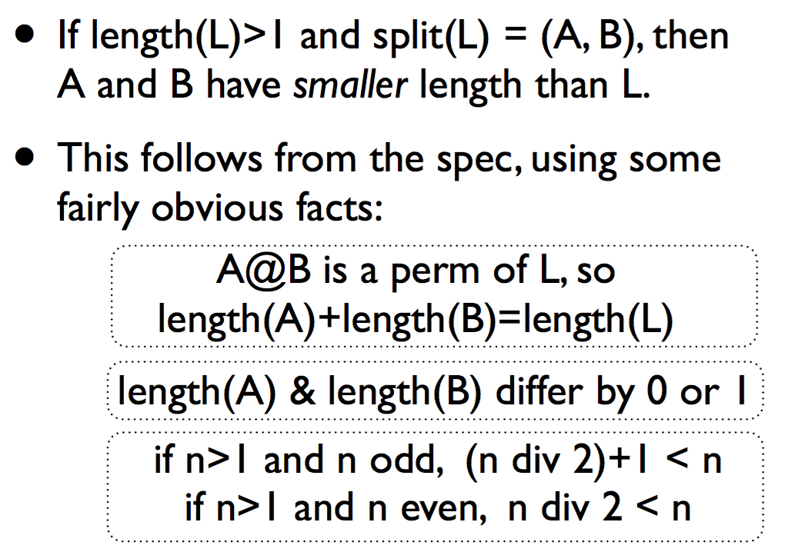
split函数的特点

Slide 16
表的分割——split
[5, 4, 3, 2, 1]怎么split的？
split : int list -> int list * int list
fun split [ ] = ([ ], [ ])
| split [x] = ([x], [ ])
| split (x::y::L) =
let val (A, B) =split L
in (x::A, y::B)
end
split (5::4::[3, 2, 1])
= split (5::4::split(3::2::split[1]))
= split (5::4::split(3::[1], 2::[ ]))
= 5::[3, 1], 4::[2]
= [5,3,1], [4,2]

Slide 17
表的合并——merge
  merge : int list * int list -> int list
(* REQUIRES A and B are <-sorted lists *)
(* ENSURES merge(A, B) = a <-sorted perm of A@B *)
fun merge (A, [ ]) = A
| merge ([ ], B) = B
| merge (x::A, y::B) = case compare(x, y) of
LESS => x :: merge(A, y::B)
| EQUAL => x::y::merge(A, B)
| GREATER => y :: merge(x::A, B)
能否写成：
merge([], []) = []?
如何证明？

Slide 18
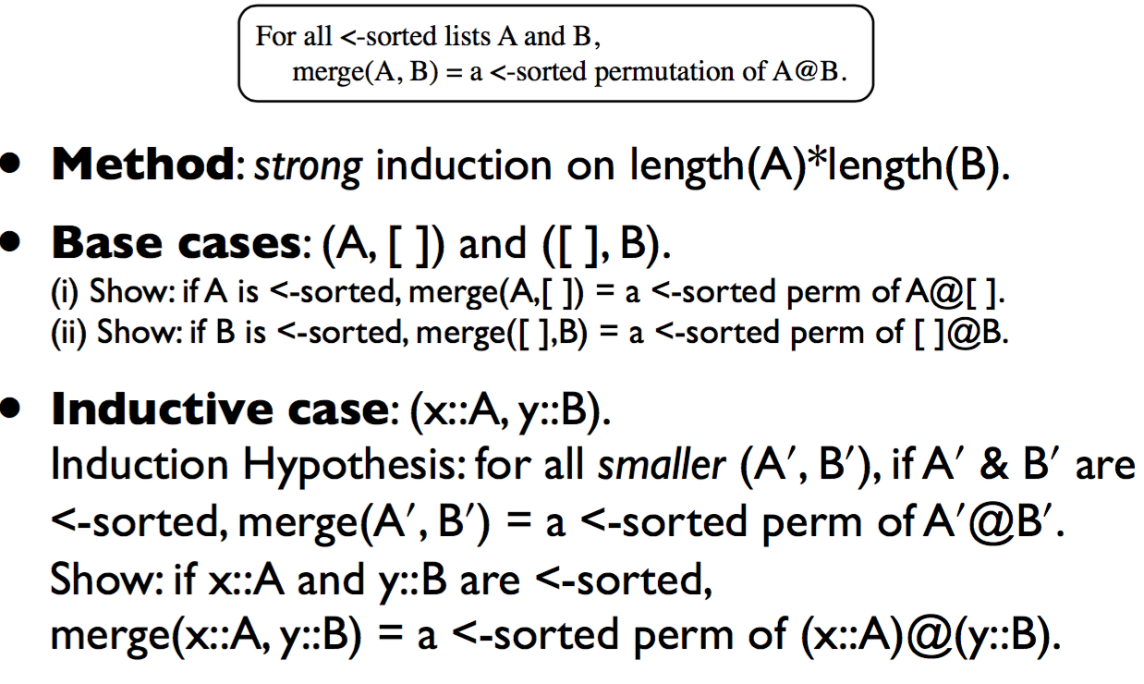
用归纳法证明Merge函数的正确性

Slide 19
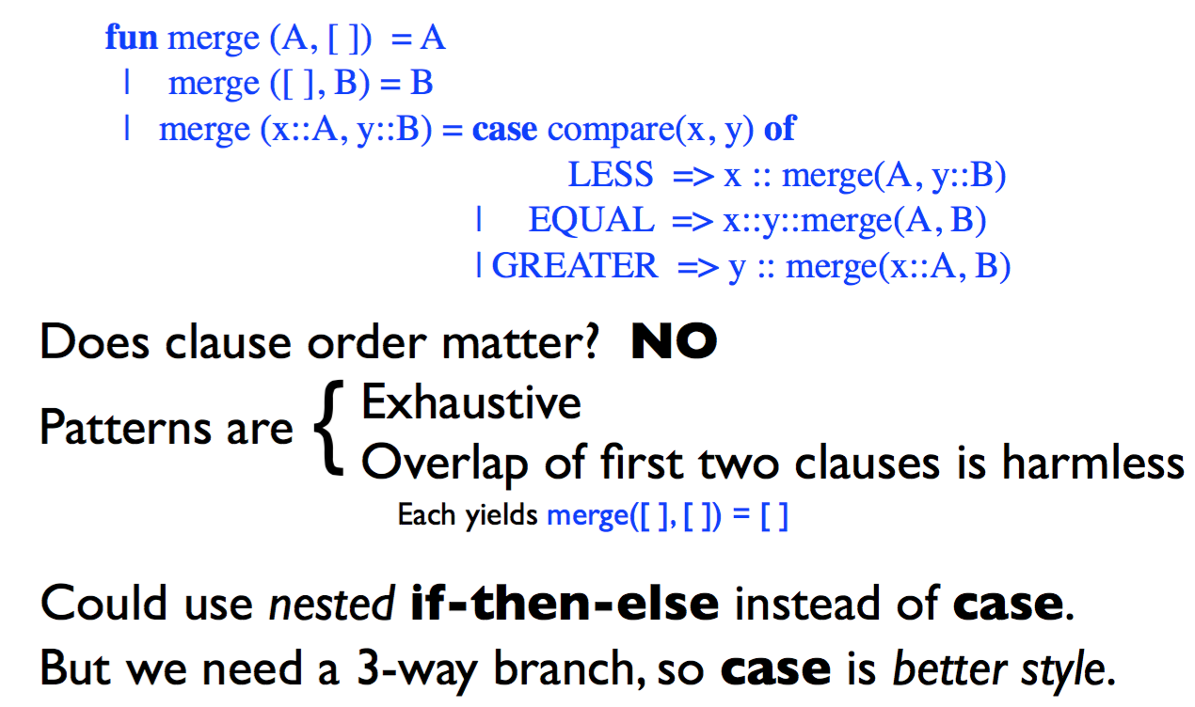
Merge函数的特点

Slide 20
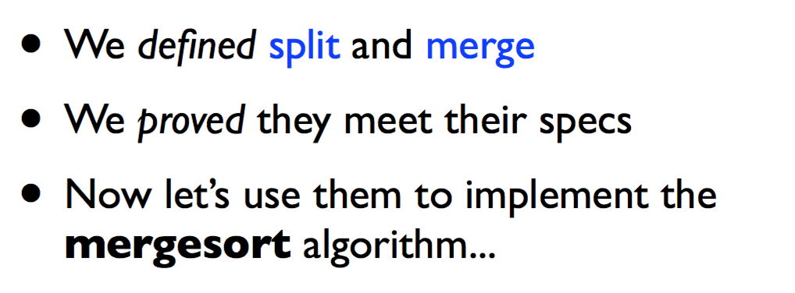
开始使用帮助(helper)函数

Slide 21
归并排序—— mergesort
msort : int list -> int list
(* REQUIRES true *)
(* ENSURES msort(L) = a <-sorted perm of L *)
fun msort [ ] = [ ]
| msort [x] = [x]
| msort L = let
val (A, B) = split L
in
merge (msort A, msort B)
end
能否去掉？
msort [1] =
=> merge(msort[1], msort[])
merge(merge(msort[1], msort[]), … ))
不断拆分split[x]

Slide 22
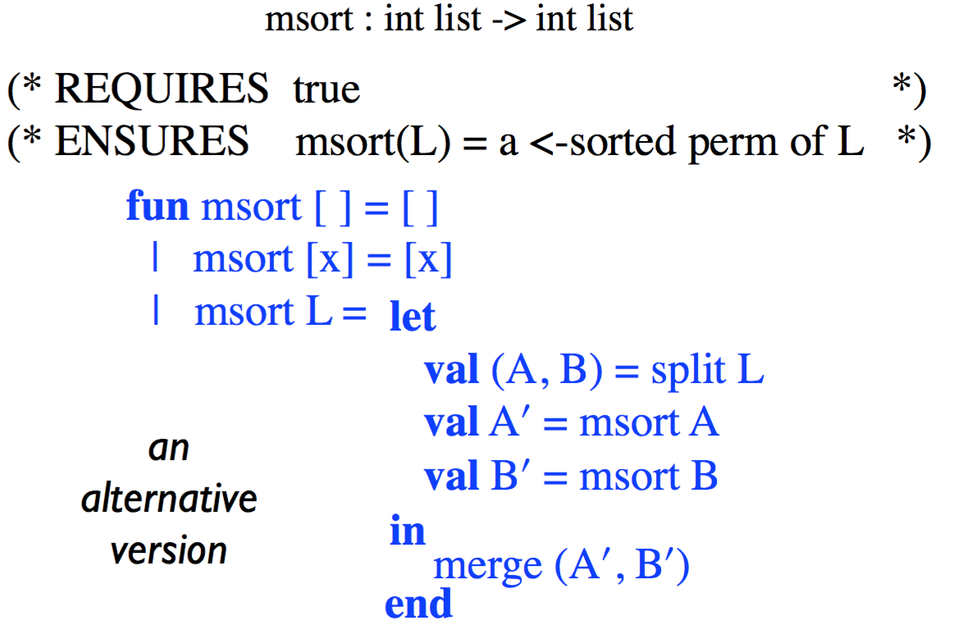
归并排序—— mergesort

Slide 23
归并排序
fun split [ ] = ([ ], [ ])
| split [x] = ([x], [ ])
| split (x::y::L) =
let val (A, B) =split L
in (x::A, y::B)
end
  fun merge (A, [ ]) = A
| merge ([ ], B) = B
| merge (x::A, y::B) = case compare(x, y) of
LESS => x :: merge(A, y::B)
| EQUAL => x::y::merge(A, B)
| GREATER => y :: merge(x::A, B)
fun msort [ ] = [ ]
| msort [x] = [x]
| msort L = let val (A, B) = split L
in merge (msort A, msort B)
end

Slide 24
msort的正确性验证
fun msort [ ] = [ ]
| msort [x] = [x]
| msort L = let
val (A, B) = split L
in
merge (msort A, msort B)
end
For all L:int list, if length(L)>1
then split(L) = (A, B)
where A and B have shorter length than L
and A@B is a permutation of L
For all L:int list,
msort(L) = a <-sorted
permutation of L.
For all sorted lists A and B,
merge(A, B)= a sorted permutation of
A@B

Slide 25
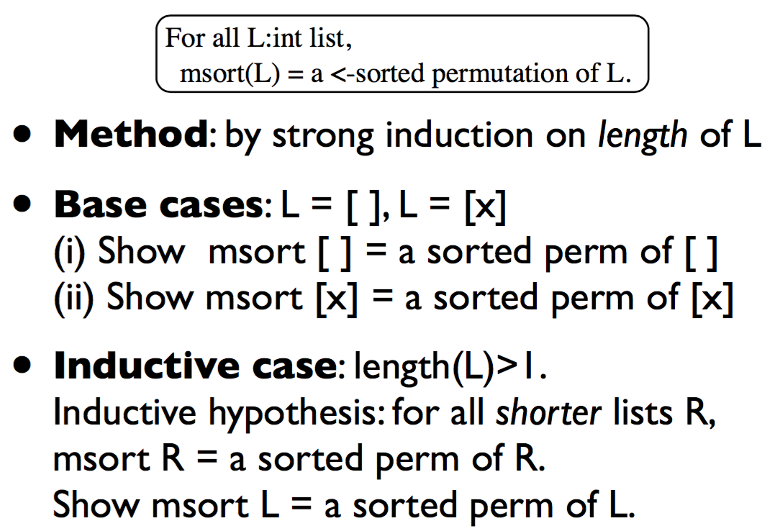
msort的正确性验证

Slide 26
ML编程原则(principles)
每个函数都对应一个功能描述说明 (Every function needs a spec)
需要验证程序符合功能描述说明 (Every spec needs a proof)
用归纳法进行递归函数的正确性验证 (Recursive functions need inductive proofs)
    选取合适的归纳法 (Learn to pick an appropriate method...)
    设计恰当的帮助函数 (Choose helper functions wisely)
msort的证明非常简单，源于函数split and merge的使用

Slide 27
功能说明的作用 (the joy of specs)
函数的证明有时依赖于某个被调用函数的证明结果(符合spec要求)
The proof for msort relied only on the specification proven for split (and the specification proven for merge)
被调用函数可以由具有相同功能说明的其他函数替换，而且证明过程仍然有效
In the definition of msort we can replace split by any function that satisfies this specification, and the proof will still be valid, for the new version of msort

Slide 28
函数替换举例
fun msort’ [ ] = [ ]
| msor’t [x] = [x]
| msort’ L = let
val (A, B) = split’ L
in
merge (msort’ A, msort’ B)
end
fun split’ [ ] = ([ ], [ ])
| split’ [x] = ([ ], [x])
| split’ (x::y::L) =
let val (A, B) =split’ L
in (x::A, y::B)
end
尽管split和split’函数不相同，但他们都满足整数表分割功能，在正确性证明过程中没有区别，所以函数msort和mosrt’都是正确的。

Slide 29
插入排序程序性能分析
fun ins (x, [ ]) = [x]
| ins (x, y::L) = case compare(x, y) of
GREATER => y::ins(x, L)
| _ => x::y::L
W_{ins}(n): the work for ins(x, L)
(length L =n)
W_{ins}(n) is O(n)
fun isort [ ] = [ ]
| isort (x::L) = ins (x, isort L)
W_{isort}(n): the work for isort(L)
(length L = n)
W_{isort}(n) is O(n²)

Slide 30
归并排序程序性能分析
  merge (A, [ ]) = A
| merge ([ ], B) = B
| merge (x::A, y::B) = case compare(x, y) of
LESS => x :: merge(A, y::B)
| EQUAL => x::y::merge(A, B)
| GREATER => y :: merge(x::A, B)
fun split [ ] = ([ ], [ ])
| split [x] = ([x], [ ])
| split (x::y::L) =
let val (A, B) =split L in (x::A, y::B)
end
W_{split}(n): work of split(L) (length(L)=n)
W_{split}(n) is O(n)
W_{merge}(n): work of merge(A,B) (length(A)+length(B)=n)
W_{merge}(n) is O(n)

Slide 31
归并排序程序性能分析
fun msort [ ] = [ ]
| msort [x] = [x]
| msort L = let
val (A, B) = split L
in
merge (msort A, msort B)
end
W_{mosrt}(n): work of msort(L) (length(L)=n)
W_{msort}(n) is O(n log n)
有没有新的数据类型能并发执行？
  Tree结构
  用树结构进行排序
msort(L)性能优于isort(L)，还能继续提升性能吗？
从程序算法上考虑：……
从数据结构上考虑：List结构为线性（顺序）结构（在[ ]基础上利用’::’进行线性扩展），因此很难提升性能（无法并发/并行）

Slide 32
树
数据类型变化：list -> tree
新的数据类型：tree
  datatype tree = Empty | Node of tree * int * tree;
  基本函数操作
用tree类型设计排序算法
tree类型排序算法的并行性能分析

Slide 33
新的类型——tree
tree：非线性数据结构
  由n(n>0)个元素组成的有限集合。每个元素称为结点(node)，一个特定的结点称为根结点(root)，且除根结点外，其余结点被分成m(m>0)个互不相交的有限集合，而每个子集又都是一棵树(子树)。
datatype tree = Empty | Node of tree * int * tree;
树的递归表述: Node(t₁, x, t₂) (t₁, t₂: tree, x: integer)

Slide 34
树的基本术语
度：结点的分支数。
叶子：度为0的结点称为叶子或终端结点。(度不为0的结点称为分支结点或非终端结点)
树的度：树中各结点的度的最大值。
双亲和孩子：结点的子树的根称为该结点的孩子，该结点称为孩子的双亲。
兄弟：同一双亲的孩子之间互称兄弟。
结点的层次：从根开始定义，根为第一层，其它结点的层次等于它的父结点的层次数加1。
深度：树的结点的最大层次称为树的深度。
路径：树中任意两个不同的结点，如果从一个结点出发，按层次自上而下沿着一个个树枝能到达另一结点，称它们之间存在着一条路径。可用路径所经过的结点序列表示路径，路径的长度等于路径上的结点个数减1。

Slide 35
树类型的模式表示与模式匹配
Empty
Node(_, _, _)
Node(Empty, _, Empty)
Node(_, 42, _)
Empty matches t 当且仅当(iff) t is Empty
Node(p1, p, p2) matches t 当且仅当(iff)
t is Node(t1, v, t2) such that
p1 matches t1, p matches v, p2 matches t2
(and combines all the bindings
when the match succeeds)

Slide 36
树的结构归纳法推导过程
证明：对所有树，P(t)成立。
结构归纳法：
Base case: 当t = Empty时，证明P(Empty)成立
Inductive case: 当 t = Node(t1, v, t2)时，
假设：P(t1)和P(t2)成立
证明：P(Node(t1, v, t2))成立。

Slide 37
树的大小—— size
size：树中的结点个数
fun size Empty = 0
| size (Node(t1, _, t2)) = size t1 + size t2 + 1;
证明：对所有树t，size(t)为非负整数(t中的结点个数)

Slide 38
树的深度(高度)—— depth
depth：组成该树各结点的最大层次
fun depth Empty = 0
| depth (Node(t1, _, t2)) = max(depth t1, depth t2) + 1;
证明：对所有树t，depth(t)为非负整数(从根到叶子结点的最长路径)

Slide 39
树的遍历
对树中所有结点信息的访问，即依次对树中每个结点访问一次且仅访问一次。树的遍历分为前序遍历、中序遍历和后序遍历。
二叉树的遍历(N:访问结点本身，L:遍历该结点的左子树，R:遍历该结点的右子树)：
NLR：前序/前根遍历(Pre-order Traversal)
LNR：中序/中根遍历(In-order Traversal)
LRN：后序/后根遍历(Post-order Traversal)

Slide 40
树的遍历函数
trav: tree -> int list
fun trav Empty = [ ]
| trav (Node(t1, x, t2)) = trav t1 @ (x :: trav t2);
对所有树t，trav(t)执行的结果为树t中所有整数的列表(中序遍历的结果)

Slide 41
有序树(sorted trees)
若将树中每个结点的各子树看成是从左到右有次序的(即不能互换)，则称该树为有序树(Ordered Tree)；否则称为无序树(Unodered Tree)。
空树(Empty)为有序树
Node(t1, x, t2)为有序树 当且仅当
  t1中的任意整数 ≤ x 且
  t2中的任意整数 ≥ x 且
  t1和t2均为有序树
trav(t)为有序表

Slide 42
插入函数的移植
？
ins : int * int list -> int list
Ins : int * tree -> tree
fun ins (x, [ ]) = [x]
| ins (x, y::L) =
case compare(x, y) of
GREATER => y::ins(x, L)
| _ => x::y::L
fun Ins (x, Empty) = Node(Empty, x, Empty)
| Ins (x, Node(t1, y, t2)) =
case compare(x, y) of
GREATER => Node(t1, y, Ins(x, t2))
| _ => Node(Ins(x, t1), y, t2);
For all sorted integer lists L,
ins(x, L) = a sorted permutation of x::L.
For all sorted integer tree t,
Ins(x, t) = a sorted tree t’ such that
trav(t’) is a perm of x::trav(t)

Slide 43
树的拆分
╳
？
Split : tree -> tree * tree
split : int list -> int list * int list
fun split [ ] = ([ ], [ ])
| split [x] = ([x], [ ])
| split (x::y::L) =
let val (A, B) =split L
in (x::A, y::B)
end
SplitAt : int * tree -> tree * tree
(* REQUIRES t is a sorted tree *)
(* ENSURES SplitAt(y, t) = a pair (t1, t2)
such that
every item in t1 is ≤ y,
every item in t2 is ≥ y,
and t1,t2 consist of the items in t *)
For all L:int list,
split(L) = a pair of lists (A, B) such that
length(A) ≈ length(B) and A@B is a perm of L.

Slide 44
树的拆分
SplitAt : int * tree -> tree * tree
(* REQUIRES t is a sorted tree *)
(* ENSURES SplitAt(y, t) = a pair (t1, t2)
such that
every item in t1 is ≤ y,
every item in t2 is ≥ y,
and t1,t2 consist of the items in t *)
fun SplitAt(y, Empty) = (Empty, Empty)
| SplitAt(y, Node(t1, x, t2)) =
case compare(x, y) of
GREATER => let
val (l1, r1) = SplitAt(y, t1)
in (l1, Node(r1, x, t2))
end
| _ => let
val (l2, r2) = SplitAt(y, t2)
in (Node(t1, x, l2), r2)
end
x>y, so x和t2应该归在右子树
  t1递归SplitAt,返回l1<y和r1>y
  l1放在左子树， r1放在右子树

Slide 45
程序的正确性验证
设P(t)表示：对所有整数y, SplitAt(y, t) = 二元组(t1, t2)，满足
t1中的每一项 ≤ y 且 t2中的每一项≥ y
且t1, t2由t中元素组成
证明：对所有有序树t，P(t)成立
定理：对所有树t和整数y,
SplitAt(y, t) = 二元组(t1, t2)，满足
depth(t1) ≤ depth t 且 depth(t2) ≤ depth t

Slide 46
树的合并
Merge : tree * tree -> tree
(* REQUIRES t1 and t2 are sorted trees *)
(* ENSURES Merge(t1, t2) = a sorted tree t *)
(* consisting of the items of t1 and t2 *)
fun Merge (Empty, t2) = t2
| Merge (Node(l1,x,r1), t2) = let
val (l2, r2) = SplitAt(x, t2)
in
Node(Merge(l1, l2), x, Merge(r1, r2))
end
For all sorted trees t1 and t2
Merge(t1, t2) = a sorted tree
consisting of the items of t1 and t2

Slide 47
树的归并排序
Msort : tree -> tree
(* REQUIRES true *)
(* ENSURES Msort(t) = a sorted tree *)
(* consisting of the items of t *)
fun Msort Empty = Empty
| Msort (Node(t1,x,t2)) =
Ins(x, Merge(Msort t1, Msort t2))
For all trees t,
Msort(t) = a sorted permutation of t

Slide 48
程序的并行执行
fun Merge (Empty, t2) = t2
| Merge (Node(l1,x,r1), t2) = let val (l2, r2) = SplitAt(x, t2)
in Node(Merge(l1, l2), x, Merge(r1, r2))
end
Merge(Msort t1, Msort t2)中的两个递归调用可以并行执行
Merge串行执行的时间开销为分别对t1和t2执行Msort的开销之和
Merge并行执行的时间开销为分别对t1和t2执行Msort开销的最大值
用”span”表示程序在足够多的并行处理器上的时间开销
Span和work的关系？

Slide 49
Ins函数的span
Ins : int * tree -> tree
fun Ins (x, Empty) = Node(Empty, x, Empty)
| Ins (x, Node(t1, y, t2)) =
case compare(x, y) of
GREATER => Node(t1, y, Ins(x, t2))
| _ => Node(Ins(x, t1), y, t2);
For a balanced tree of depth d>0,
SIns(d) = c + SIns(d-1)
SIns(d) is O(d)
平衡二叉树：它是一 棵空树或它的左右两个子树的高度差的绝对值不超过1，并且左右两个子树都是一棵平衡二叉树。

Slide 50
SplitAt函数的span
SplitAt : int * tree -> tree * tree
fun SplitAt(y, Empty) = (Empty, Empty)
| SplitAt(y, Node(t1, x, t2)) =
case compare(x, y) of
GREATER => let
val (l1, r1) = SplitAt(y, t1)
in (l1, Node(r1, x, t2))
end
| _ => let
val (l2, r2) = SplitAt(y, t2)
in (Node(t1, x, l2), r2)
end
For a balanced tree of depth d>0,
SSplitAt(d) = k + SSplitAt(d-1)
SSplitAt(d) is O(d)

Slide 51
Merge函数的span
Merge : tree * tree -> tree
fun Merge (Empty, t2) = t2
| Merge (Node(l1,x,r1), t2) = let
val (l2, r2) = SplitAt(x, t2)
in
Node(Merge(l1, l2), x, Merge(r1, r2))
end
For balanced trees of same depth d>0,
SMerge(d) = SSplitAt + max(SMerge(d-1), SMerge(d-1) )
SMerge(d) is O(d²)

Slide 52
Msort函数的span
For balanced trees of same depth d>0,
Msort : tree -> tree
fun Msort Empty = Empty
| Msort (Node(t1,x,t2)) =
Ins(x, Merge(Msort t1, Msort t2))
SMsort(d) is ?O(d³)
fun Msort Empty = Empty
| Msort (Node(t1, x, t2)) =
Rebalance(Ins (x, Merge(Msort t1, Msort t2)))

Slide 53
类型检测 (Type checking)
多态特点 (Polymorphism)
类型推导 (Type inference)
多态特征 (Polymorphism)

Slide 54
类型分析 (type analysis)
静态类型检测能提供运行保障 (a static check provides a runtime guarantee)
ML程序的基本特点：强类型(well-typed)
——确保程序运行不会出错
    ML只处理well-typed的表达式 (ML only evaluates well-typed expressions)
    If e has type t and e =>* v, then v is a value of type t.
    ML只处理well-typed的声明 (ML only evaluates well-typed declarations)
    If d declares x of type t, then d binds x to a value of type t
    ML只处理well-typed的模式匹配 (ML only performs well-typed pattern matches)
变量有且只有一种类型

Slide 55
类型的引用透明性 (Referential transparency)
表达式类型依赖于子表达式的类型，依赖于自由变量的类型 (The type of an expression depends on the types of its sub-expressions and the types of its free varables)
x + x
has type int ？
has type real ？
if x has type int
if x has type real
ML标记出所有常量类型，并且将类型检测规则应用到每种形式的表达式上
什么时候检测和
确定类型？

Slide 56
类型分析的时机
编译时进行类型分析和确定(type analysis can be done at compile time)
  语法导向(syntax-directed)规则用于表达式的类型判定：表达式e的类型t依赖于表达式中自由变量的类型
  表达式e和类型t的语法规范是规则的基础
e is well-typed, with type t,
if and only if provable from these rules

Slide 57
类型规则(Typing rules)
基于某种假设，有如下语法导向规则(syntax-directed rules):
  e has type t
  d declares x : t
  p fits type t and binds x : t
数学运算(Arithmetic)：
  0, 1, 2, ~1, ... have type int
  0.0, 1.1, ~2.0, ... have type real
  e1 + e2 has type int if e1 and e2 have type int
  e1 + e2 has type real if e1 and e2 have type real
similarly
e1 - e2
e1 * e2
e1 + e2 is not well-typed, otherwise

Slide 58
类型规则(Typing rules)
similarly
e₁ > e₂
e₁ <=* e₂
2. 表达式比较(Comparison)
  e1 < e2 has type bool if e1 and e2 have type int
  e1 < e2 has type bool if e1 and e2 have type real
e1 < e2 is not well-typed, otherwise
3. 分支语句 (Conditional for all types t)
  if e then e1 else e2 has type t
if e has type bool and e1, e2 have type t
if e then e1 else e2 is not well-typed, otherwise
both branches
must have
the same type

Slide 59
类型规则(Typing rules)
4. 元组 (Tuples for all type t₁ and t₂)
  (e₁, e₂) has type t₁ * t₂ if e₁ has type t₁ and e₂ has type t₂
Similarly for (e₁, ..., e_{k}) when k>0
( ) has type unit
5. 表(List for all type t)
  [e₁, ..., e_{n}] has type t list if for each i, e_{i} has type t n≥0
  e₁::e₂ has type t list if e₁ has type t and e₂ has type t list
  e₁@e₂ has type t list if e₁ and e₂ have type t list

Slide 60
类型规则(Typing rules)
6. 函数 (Functions)
  fn x => e has type t₁ -> t₂ if, assuming x : t₁, e has type t₂
fn x => e is not well-typed, if no such t₁ and t₂ exist
7. 应用(Application)
  e₁ e₂ has type t₂ if e₁ has type t₁ -> t₂ and e₂ has type t₁
e₁ e₂ is not well-typed, otherwise
if e₁ does not have a function type,
or e₁ has type t₁ -> t₂ but e₂ doesn’t have type t₁

Slide 61
类型规则(Typing rules)
8. 声明 (Declarations)
  val x = e declares x : t if e has type t
  fun f x = e declares f : t₁ -> t₂
  if, assuming x : t₁ and f : t₁ -> t₂, e has type t₂
(also rules for combining declarations)
val x = 42
fun f(y) = x+y
declares：
x : int and f : int -> int

Slide 62
类型规则(Typing rules)
9. let表达式 (let expressions)
  let d in e end has type t₂
if d declares x : t₁, ..., e has type t₂
let
val x = 21
fun f(y) = x+y
in
x + (f x)
end
let
val x = 21
in
x + x
end
has type int

Slide 63
类型规则(Typing rules)
10. 模式 (Patterns)
  _ fits t
  42 fits t
  x fits t
  (p1, p2) fits t
  p1::p2 fits t
  always
  iff t is int
  always
  iff t is t1*t2, p1 fits t1, p2 fits t2
  iff t is t1 list, p1 fits t1, p2 fits t1 list

Slide 64
规则的应用：模式
When p fits t,
what type bindings does it produce ?
• Fitting _ to t
• Fitting x to t
• Fitting (p₁, p₂) to t₁ * t₂
• Fitting p₁::p₂ to t₁ list
produces no bindings
produces x:t
produces the bindings
from fitting p₁ to t₁ and p₂ to t₂
produces the bindings
from fitting p₁ to t₁ and p₂ to t₁ list

Slide 65
规则的应用：函数
fn p₁ => e₁ | ... | p_{k} => e_{k} has type t₁ -> t₂
if for each i,
fitting p_{i} to t₁ succeeds,
with type bindings for which e_{i} has type t₂
fn 0 => 0 | n => n - 1
has type int -> int

Slide 66
规则的应用：递归函数
fun f p₁ = e₁ | ... | f p_{k} = e_{k} declares f : t₁ -> t₂
if for each i,
matching p_{i} to t1 succeeds,
with type bindings for which,
assuming f : t₁ -> t₂, e_{i} has type t₂
fun f 0 = 0 | f n = f (n - 1)
fun f n = if n=0 then 1 else n + f (n - 1)

Slide 67
多态类型(Polymorphic types)
多态：多种形态。
类型推导后剩下一些无约束的类型，则声明就是多态的。
• ML has type variables
’a, ’b, ’c
• A type with type variables is polymorphic
’a list -> ’a list
• A polymorphic type has instances
int list -> int list
real list -> real list
(int * real) list -> (int * real) list
. .. instances of ’a list -> ’a list
多态类型是一个类型模式，用类型替换类型变量就形成一个类型模式的实例(instance)

Slide 68
多态的应用：split
fun split [ ] = ([ ], [ ])
| split [x] = ([x], [ ])
| split (x::y::L) =
let val (A,B) = split L in (x::A, y::B) end
declares
  split : int list -> int list * int list
多态的好处：
避免写较多多余的代码
便于维护
declares
split : ’a list -> ’a list * ’a list

Slide 69
多态的应用：sorting
Assuming split : int list -> int list * int list
merge : int list * int list -> int list
fun msort [ ] = [ ]
| msort [x] = [x]
| msort L = let
val (A,B) = split L
in
merge (msort A, msort B)
end
declares msort : int list -> int list

Slide 70
多态的应用：sorting
Assuming split : ‘a list -> ‘a list * ‘a list
merge : int list * int list -> int list
fun msort [ ] = [ ]
| msort [x] = [x]
| msort L = let
val (A,B) = split L
in
merge (msort A, msort B)
end
is not well-typed
declares msort : ’a list -> int list
problem?

Slide 71
多态类型的推导(typability)
t is a type for e
iff (e has type t) is provable
In the scope of d, x has type t
iff (d declares x:t) is provable
If e has type t, and t’ is an instance of t, then e also has type t’
list的反转函数：rev：’a list -> ’a list
int list -> int list is a type for rev
real list -> real list is a type for rev
’a list -> ’a list is a type for rev

Slide 72


普通类型(Most general types)
普通类型：
t is a most general type for e
iff every instance of t is a type for e
& every type for e is an instance of t
Every well-typed expression has a most general type
rev has most general type ’a list -> ’a list

Slide 73
类型推导(type inference)
ML computes most general types
• statically, using syntax as guide
Standard ML of New Jersey v110.75
fun rev [ ] = [ ] | rev (x::L) = (rev L) @ [x];
val rev = fn : 'a list -> 'a list

Slide 74
多态类型
ML allows parameterized datatypes
datatype ’a tree = Empty
| Node of ’a tree * ’a * ’a tree
a type constructor tree
and polymorphic value constructors
Empty : ’a tree
Node : ’a tree * ’a * ’a tree -> ’a tree
fun trav Empty = [ ]
| trav (Node(t1, x, t2)) = (trav t1) @ x :: (trav t2)
declares trav : ’a tree -> ’a list

Slide 75
Options类型
datatype ’a option = NONE | SOME of ’a
option：将空值和一般值包装成同一种类型。
  NONE：空值option
  SOME e：把表达式e的值包装成对应的option类型数据
  isSome t：查看t是否为SOME，如果t为NONE，则返回false
  如果t为SOME，则返回true
  valOf t：得到SOME包装的值。如valOf (SOME 5) = 5

Slide 76
Options类型
datatype ’a option = NONE | SOME of ’a
fun try (f, [ ]) = NONE
| try (f, x::L) = case (f x) of
NONE => try (f, L)
| y => y
try : (’a -> ’b option) * ’a list -> ’b option

Slide 77
相等性 (equality)
等式类型：该类型的值能够进行相等性测试
用“=”进行相等性判断
  int类型
  用等式类型构建的元组或表
  real和函数类型不是等式类型
等式类型表示为’’a, ’’b, ’’c
使用时必须实例化

Slide 78
等式类型举例
fun mem (x, [ ]) = false
| mem (x, y::L) = (x=y) orelse mem (x, L)
Declares mem : ’’a * ’’a list -> bool
实例化：int * int list -> bool
(int list) * (int list) list -> bool
real * real list -> bool
X

